Slide 1
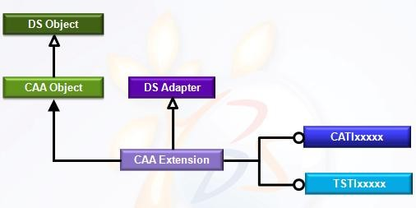
Object Modeler
R2010x

Slide 2


Table Of Contents
Overview | p | 3
Definitions | p | 5
Extension Types | p | 10
TIE Notion | p | 11
BOA Notion | p | 16
Life Cycle | p | 18
Conclusion | p | 21

Slide 3


Overview (1/2)
The Object Modeler defines an Interface Mechanism to handle objects
The Object Modeler enables:
a build independence:
applications are built only on interfaces
application rebuild is not necessary for implementation modification
on demand dll loading
for example toolbar dlls are loaded when corresponding workbench is launched
an object behavior federation
it is possible to add the same behavior to different types of objects
an open architecture
A customer may:
→ create it own object inheritance architecture
→ implement Dassault Systèmes interfaces on its own objects
→ implement its own interfaces on Dassault Systèmes objects and on its own objects
3

Slide 4

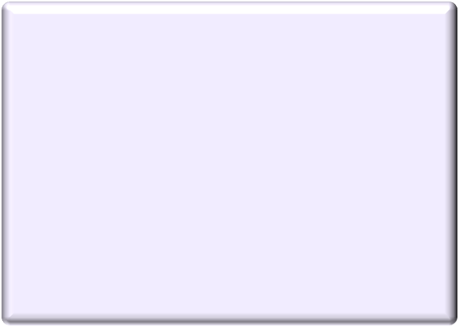








Overview (2/2)
The Object Modeler is a Dassault Systèmes modeler relying on:
C++
Object Inheritance Polymorphism
Introspection of objects type at runtime
→ RTTI : Run-Time Type Information
APPLICATIONS
Mechanical Modeler
APPLICATIVE MODELER
Human Machine Interface
USER INTERFACE
COM
DATA MODELER
GEOMETRICAL MODELER
All DS objects inherit at least from the
IUnknown COM interface enabling to:
→ get a object behavior from another one (QueryInterface() method)
→ get interface query return code (HRESULT)
→ handle lifecycle management (AddRef() & Release() methods)
VISUALIZATION
OBJECT MODELER
C++ COM CORBA
Object Modeler has:
deactivated RTTI
defined CATBaseUnknown as the mandatory base class inheriting from IUnknown interface
→ get the class name (ClassName())
→ know if the object inherit from another (IsAKindOf())
IUnknown
CATBaseUnknown
4

Slide 5








Component Definition
A Component is composed of :
A Base Object
All its extensions
Dictionary
TSTComponent TSTIInterface0 libTSTSharedLibrary0 TSTComponent TSTIInterface1 libTSTSharedLibrary1 TSTComponent TSTIInterface2 libTSTSharedLibrary2
…
Component name
TSTComponent
Base Object
TSTIInterface0
virtual HRESULT Method0(…) = 0;
Component
TSTEIntf1OnComp
TSTIInterface1
HRESULT
Method1(…);
virtual HRESULT Method1(…) = 0;
« extends »
TSTEIntf2OnComp
TSTIInterface2
HRESULT
Method2(…);
virtual HRESULT Method2(…) = 0;
5

Slide 6



Interface Definition
Interfaces are contracts between clients and implementations
Interfaces should never change in order not to rebuild applications for each implementation
change
The client application deals with components only through interfaces
Interfaces shield the application code from the component implementation details
A component can implement one or more interfaces
these interfaces are the component external view
An interface is an abstract class with a set of pure virtual methods that
defines an object behavior
Client Application
<<implements>>
<<uses>>
TSTComponent
TSTInterface
Convention: the 4th character of an interface name is an « I »
6

Slide 7




Base Object Definition
A Base Object is:
an Implementation Object is a C++ class which can implement several interfaces
TSTImplObj.cpp
TSTImplObj.h
TSTIInterface.h
HRESULT TSTImplObj::GetX(…)
{...}
HRESULT TSTImplObj::GetY(…)
{…}
HRESULT GetX(…); HRESULT GetY(…);
HRESULT virtual GetX(…) = 0; HRESULT virtual GetY(…) = 0;
TSTIInterface.cpp
ø
a Late Type is a concept represented by a character string to which some behaviors can be added through the extension mechanism
7

Slide 8



Interface/Implementation
How to add new behaviors (methods) on a component without having access to its implementation?
TSTIPointCoordinates
virtual HRESULT GetX(…) = 0 virtual HRESULT GetY(…) = 0
TSTComponent
HRESULT GetX(…) HRESULT GetY(…)
TSTIPointColor
HRESULT GetColor(…)
virtual HRESULT GetColor(…) = 0
How to separate the implementation of interfaces on the same component in order to benefit from on demand dll loading?
How to split semantically the implementation code?
Coordinates does not mean the same thing than color
8

Slide 9











Component Extension Definition
Convention: the 4th character of the extension name is an « E »
Wizard: the component name is the implementation class name
A component extension is a C++ class that adds new capabilities through
new interfaces to an existing component
Hence the component definition is extended by:
the implementation object all its extensions
TSTFramework.dico
TSTComponent | TSTIInterface1 | libTSTSharedLibrary1
TSTComponent | TSTIInterface2 | libTSTSharedLibrary2
TSTComponent | TSTIInterface3 | libTSTSharedLibrary2
TSTComponent | TSTIInterface4 | libTSTSharedLibrary3
Component name
TSTIInterface1
TSTComponent
virtual HRESULT Method1(…) = 0;
Implementation class
TSTComponent
TSTIInterface2
HRESULT Method1(…);
virtual HRESULT Method2(…) = 0;
Component
TSTEIntfaOnComp
TSTIInterface3
HRESULT Method2(…); HRESULT Method3(…);
virtual HRESULT Method3(…) = 0;
« extends »
9
NOTE this whole
thing is Component
TSTEIntfbOnComp
TSTIInterface4
Extension
HRESULT Method4(…);
virtual HRESULT Method4(…) = 0;
9
classes

Slide 10

Extension Types
There two extension types:
DataExtension
Extension class can contains methods and data member One single extension instance for each component instance Data extensions are deleted when the component is deleted
CodeExtension
Extension class must not contain any data member
One single extension instance for all the component instances(since one VTable will be created for a Class and memory will be allocated to this functions only once thus here for understanding One to Many relationship)
To be carefully handled (“this” must not be used either implicitly or explicitly in the code extension class)
Code extensions are deleted at the end of the CATIA session
If you don’t know which kind of type extension is the best for your scenario choose the DataExtension one
CATImplementClass (<this ClassName>,
<its Extension Type>,
<its Inheritance>,
<what it extends>)

Slide 11



TIE Definition
A TIE is a C++ class allowing the client application to use the component implementation through the interface contract
Client Application
<<implements>>
<<uses>>
Component
Interface
« TIE »
TIE header file will be generated if you create a file TIE_TSTIxxx.tsrc that just includes the interface header file TSTIxxx.h
generated by the Visual Studio wizard during the interface creation
TSTInterfaceFw/TSTModule.m/TSTIInterface.tsrc
// Code Generated by the CAA Wizard
// This source file insures the regeneration of the tie TIE_TSTIInterface.h #include "TSTIInterface.h"
mkmk
TSTInterfaceFw/ProtectedGenerated/intel_a/TIE_TSTIInterface.h
…

Slide 12







TIE Mechanism (1/2)
Every request to an interface method is redirected to the corresponding component method implementation through a TIE class instance
TSTFramework.dico
TSTComponent TSTIInterface1 libTSTSharedLibrary1
…
QueryInterface() from component to interface
TSTComponent
TSTIInterface1
HRESULT Method1(…);
virtual HRESULT Method1(…) = 0;
A pointer on an interface implemented in TIE mode is a pointer on the corresponding TIE class
Redirection
TIE_TSTIInterface1TSTComponent
HRESULT
TIE_TSTIInterface1TSTComponent::Method1()
{
return (pComponent→ Method1());
}
# include ″TSTComponent.h″ # include ″TSTIInterface1.h″
...
Customer Code
TSTComponent* pComponent = new TSTComponent(); TSTIInterface1* piInterface1OnComponent = NULL; pComponent →QueryInterface (IID_TSTIInterface1,
(void**)& piInterface1OnComponent); piInterface1OnComponent → Method1(...);
Internal DS Code
piInterface1OnComponent =
new TIE_TSTInterface1TSTComponent(pComponent);

Slide 13









TIE Mechanism (2/2)
QueryInterface() from interface to another one:
TSTFramework.dico
TSTIInterface1
TSTComponent TSTIInterface1 libTSTSharedLibrary1 TSTComponent TSTIInterface2 libTSTSharedLibrary2
…
virtual HRESULT Method1(…) = 0;
TSTComponent
TIE_TSTIInterface1TSTComponent
HRESULT Method1(…); HRESULT Method2(…);
Redirection
# include ″TSTComponent.h″ # include ″TSTIInterface1.h″ # include ″TSTIInterface2.h″
...
Customer Code
TSTIInterface2
virtual HRESULT Method2(…) = 0;
TSTIInterface2* piInterface2OnComponent = NULL; piInterface1OnComponent →QueryInterface (IID_TSTIInterface2,
(void**)& piInterface2OnComponent ); piInterface2OnComponent → Method2(...);
TIE_TSTIInterface2TSTComponent
HRESULT
TIE_TSTIInterface2TSTComponent::Method2()
{
return (pComponent→ Method2());
}
Internal DS Code
piInterface1OnComponent → GetComponent (pComponent); piInterface2OnComponent =
new TIE_TSTInterface2TSTComponent(pComponent);

Slide 14







Standard TIE And Chained TIE Introduction
There are two kinds of TIE
Standard TIE
always create an instance of the TIE class when QueryInterface() is used
Chained TIE
only one TIE instance created when several QueryInterface() are done on the same
component instance to get several pointers of the same interface
→ Each Component has an interface chained list filled with a new interface at each
QueryInterface() only if it is not already in the list
TSTComponent* pComponent = …; _{Customer Code}
…
TSTIInterface* pi1InterfaceOnComponent = NULL; pComponent →QueryInterface (IID_CATIInterface,
(void**)& pi1InterfaceOnComponent);
…
TSTIInterface* pi2InterfaceOnComponent = NULL; pComponent →QueryInterface (IID_CATIInterface,
(void**)& pi2InterfaceOnComponent);
TSTComponent TSTIInterface
Chained list:
→ …
→TSTIInterface
Internal DS Code Chained TIE
TSTInterface* pChainedInterface =
pComponent → ChainedList (IID_TSTInterface)
TIEchain_ TSTIInterfaceTSTComponent* pi1InterfaceOnComponent =
new TIEchain_ TSTIInterfaceTSTComponent();
…
TSTInterface* pChainedInterface =
pComponent → ChainedList (IID_TSTInterface) pi2InterfaceOnComponent = pChainedInterface;
pi2InterfaceOnComponent → AddRef();
Internal DS Code
TIE_ TSTIInterfaceTSTComponent* pi1InterfaceOnComponent =
Standard TIE
new TIE_ TSTIInterfaceTSTComponent();
…
TIE_ TSTIInterfaceTSTComponent* pi2InterfaceOnComponent =
new TIE_ TSTIInterfaceTSTComponent();
14

Slide 15








TIE Recommendation
If you don’t know which kind of TIE is the best on your scenario choose the standard one
Effectively in some cases chained TIE may lead to:
CPU use increasing
for instance if a component has several interfaces implemented with a Chained TIE the chained list could be huge if we use a lot of behaviors
TSTIInterface1
« Chained TIE »
QueryInterface()
TSTIInterface2
TSTComponent
Chained list:
« Chained TIE »
QueryInterface()
...
« Chained TIE »
QueryInterface()
→TSTInterface1
→TSTInterface2
→ …
→TSTInterfaceN
TSTIInterfaceN
« Chained TIE »
memory consumption increasing
for instance if there are a lot of component instances and if we use several of their behaviors the memory will increase strongly
→ TIE objects are not deleted until the component is deleted
tricky debugging to manage the interface pointer lifecycle (see lifecycle chapter)
15

Slide 16






BOA (Basic Object Adapter)
Component extension can be implemented in TIE mode but also in BOA
In BOA mode the component extension class inherits from the interface
there is no intermediate object unlike TIE
« TIE »
TSTComponent TSTIInterface1
HRESULT Method1(…)
virtual HRESULT Method1(…) = 0
A pointer on an interface implemented in BOA mode is a pointer on the
corresponding extension class
« extends »
TSTIInterface2
virtual HRESULT Method2(…) = 0
TSTFramework.dico
« BOA »
TSTComponent TSTIInterface1 libTSTSharedLibrary1 TSTComponent TSTIInterface2 libTSTSharedLibrary2
…
TSTIntf2OnComp
virtual HRESULT Method2(…)
Customer Code
Internal DS Code
TSTInterface1* piInterface1OnComponent = …; TSTIInterface2* piInterface2OnComponent = NULL; piInterface1OnComponent →QueryInterface
piInterface1OnComponent → GetComponent (pComponent);
piInterface2OnComponent =
pComponent → GetExtension (“TSTEIntf2OnComp”); If (NULL == piInterface2OnComponent )
piInterface2OnComponent = new TSTEIntf2OnComp ();
(IID_TSTIInterface2, (void**)& piInterface2OnComponent);
piInterface2OnComponent → Method2(...);

Slide 17
BOA Recommendations
Advantages:
Don’t create TIE object (save memory)
Direct access to component (better CPU performances)
Restrictions:
A component implement / extension class can implement only one interface in BOA mode
multiple inheritance is forbidden in CAA
If the interface has an adapter class you can only implement it in BOA mode if the adapter inherits from the interface
Code extension and BOA are not compatible
Implementing some DS interfaces with BOA may not be authorized
Refer to the CAA documentation (ex : CATIModelEvents)
Recommendations:
In term of architecture it is better to implement interfaces in TIE mode for component
implementation classes
Otherwise the interface pointer will be a direct cast of the component
If you don’t know which mode is the best for your scenario
Use BOA with extensions and implement a single interface per extension Use TIE otherwise

Slide 18




Life Cycle (1/2)
A component must be deleted when its behaviors are no longer used
Lifecycle is managed by a COM counter mechanism
AddRef() to increment the counter
Release() to decrement the counter
Object will be deleted if the counter equals zero
IUnknown
AddRef () Release () QueryInterface()
The TIE / Extension counter
is already incremented when you get an interface pointer from any methods as QueryInterface()
must be incremented when you get an interface pointer thanks to an affectation
CATBaseUnknown
must be decremented each time you don’t need it any longer
The Component counter
is managed automatically when one of its
interfaces is “AddRef()/Release()”
TSTComponent TSTIInterface
Components are deleted when their counters are equal to zero
Standard TIE are deleted once their counter is equal to zero
Chained TIEs and Data extensions are deleted when the component is deleted

Slide 19













Life Cycle (2/2)
Component
« Data »
E1
« Standard TIE »
I1
« Extension »
a Chained TIE behave like a Standard TIE if it is implemented with a Code extension
« Data »
« ChainedTIE »
E2
I2
« Data »
E3
« BOA »
I3
« Code »
E4
« Standard TIE »
I4
« Code »
E5
« ChainedTIE »
I5
I5 = TIE5
Interface implemented in a
E5
Code
Standard TIE extension is
deleted when it is released
extension are
I4 = TIE4
deleted at the
end of the
E4
session
Data extension are
I3 = E3
deleted when the
component is deleted
Interface implemented
I2 = TIE2
in a Chained TIE
extension is deleted
E2
when the component is
Component is deleted
I1 = TIE1
deleted
when all its interfaces has
been released
E1
Component
New | QI | Delete | QI | Release | QI | Release | QI | Release | QI | Release Release | End
Comp | I1 | Comp | I2 | I1 | I3 | I2 | I4 | I3 | I5 | I4 I5 | Session

Slide 20













Example
TSTPoint
« Standard TIE »
TSTIPoint
TSTMain.cpp
TSTIFactory * piFactory = …; TSTIPoint * piPoint = NULL; piFactory → CreatePoint (&piPoint ); piPoint → QueryInterface(IID_ TSTIColor, (void**)& piColor); piPoint → Release(); piPoint = NULL; … piColor → QueryInterface(IID_ TSTICoord, (void**)& piCoord); piColor → Release(); piColor = NULL; … piCoord→ QueryInterface(IID_ TSTIMove, (void**)& piMove); piCoord → Release(); piCoord = NULL; … piMove → Release(); piMove = NULL; … Delete_Session (“TestSession”);
« Extension »
« Code »
« Standard TIE »
TSTEColorOnPoint
TSTIColor
« Data »
TSTECoordOnPoint
« ChainedTIE »
TSTICoord
« Data »
TSTEMoveOnPoint
« BOA »
TSTIMove
pPoint
piPoint
1 2 1 2 1 2 1 2 1 0
1 0
piEColor (Extension)
piColor
1 0
1 0
TSTEFactory.cpp
HRESULT CreatePoint (TSTIPoint** oppiPoint)
{
…
TSTPoint* pPoint = new TSTPoint();
rc = pPoint → QueryInterface(IID_ TSTIInterface,
(void**) oppiPoint); pPoint → Release(); pPoint = NULL;
…
}
piECoord (Extension)
piCoord
1 0
1 0
piEMove (Extension)
1 0
20

Slide 21
Conclusion
Best practices
Use BOA when it is possible
Code extension and BOA are not compatible(maybe Since Code Extensions are deleted at the end of the session)
Implementing some DS interfaces with BOA may not be authorized
…
Use TIE otherwise
Use mainly standard TIE, chained TIE might be useful only for DS implementations Use mainly data extension
21

Slide 22
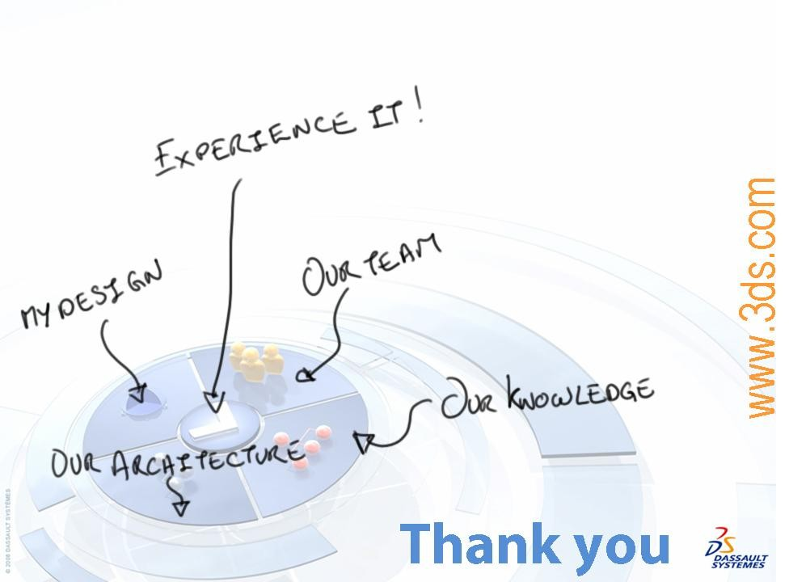


Software Quality and Delivery
Here is the next step to follow:
1. Software Quality Management
2. Exercise: Create an ODT
3. Software Delivery Management
4. Exercise: Launch a CAA application from an environment

